Slide 1
Calibrate to Power
Peter Stuart
Notes:
Please note this was last updated in March 2017 – if you have any comments on content / figures please contact designuk@res-group.com
Logo updated: RES power for good

Slide 2
Traditional Approach
Traditional Resource Assessment Approach

Slide 3
Traditional Approach: Step 1
Calibrate (validate) LiDAR to Met Mast Anemometer.
Anemometer Calibrated in Wind Tunnel
LiDAR Serial number ABC123

Slide 4
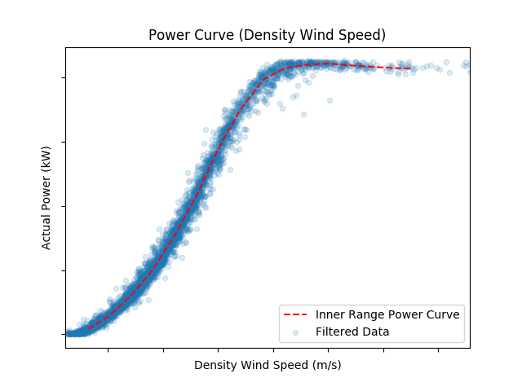
Traditional Approach: Step 2
Measure Power Curve on test site
Power Curve
Power
Wind Speed
(absolute)

Slide 5
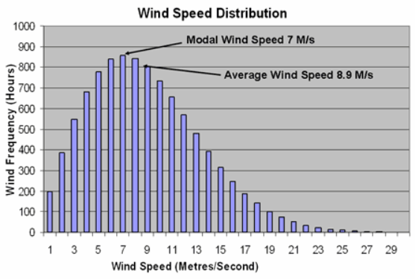
Calibrate to Power: LiDAR Specific Power Curve Measurement
Measurement on target site (pre-construction)
X
=EY
MWh
Absolute Wind Speed
Absolute Wind Speed

Slide 6
Calibrate to Power Approach
Calibrate to Power
Resource Assessment

Slide 7
Calibrate to Power: LiDAR Specific Power Curve Measurement
Measurement on Site A (Training):
Existing Operational Turbine Model WT100
Site B
Site A
Power Curve
WT100 Power
LiDAR Serial number ABC123
Wind Speed as Measured by ABC123

Slide 8
Transport Same Physical LiDAR (Serial ABC123)
Move LiDAR (same physical device) to site B.
Site B
Site A

Slide 9
Calibrate to Power: LiDAR Specific Power Curve Measurement
Measurement on Site B (Application):
Pre-construction Site for Model WT100
X = planned turbine location
Site B
Site A
X
=EY
MWh
WT 100 Power
Wind Speed
Measured by ABC123
(on Site B)
Wind Speed
Measured by ABC123
(on Site A)
X
LiDAR Serial number ABC123

Slide 10
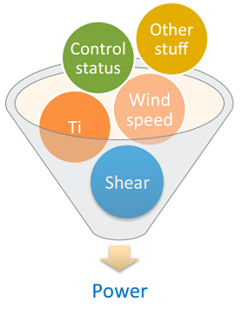
Machine Learning
This approach would like itself to advance statistical modelling approaches e.g. machine learning.
This would mean ‘outer range’ considerations would be inherently addressed (as long as training data sufficient).
Traditional Power Cure
Machine Learning
WT 100 Power
Wind Speed
Power Curve Measured by ABC123
(from Site A)
A Clifton http://www.nrel.gov/docs/fy13osti/58314.pdf

Slide 11
Training site (e.g. prototype install)
Q. How Long does the training measurement need to be?
6 months
Measurement at training site
Target site (pre-construction)
12 months measurement at target site
=> Machine Identification
18 months out

Slide 12
Training site (e.g. prototype install)
Use of transfer LiDAR to shorten duration
6 week measurement (very low standard error)
Purple
Existing (purple) at training location
Blue
Target site (pre-construction)
6 week measurement (very low standard error)
Green
Move transfer (blue) LiDAR from training to target site
Blue
Machine Identification
3 months out
Existing (green) at target location

Slide 13
Benefits & Next Steps
Benefits
Site step major measurement uncertainty component (no requirement to reference LiDAR measurement to Anemometer).
Provide highly specific training dataset to advanced statistical methods (specific to turbine model and specific to physical LiDAR).
Lower overall yield uncertainty, assist project design and inform turbine selection (lower £/MWh).
Could be extended to loading analysis if loading sensors on training site.
Next Steps
RES is planning to trial approach on two operational sites in 2018.
Training Site (Site A)
Validation Site (Site B)
RES is open to collaboration with industry stakeholders

Slide 14
Acknowledgements
This presentation expands upon ideas originally voiced by Matt Smith of ZephIR.

